Slide 1
Envisioning Outlier Exposure by Large Language Models for Out-of-Distribution Detection
ICML 2024
Ruiyao Xu
2024/11/08

Slide 2
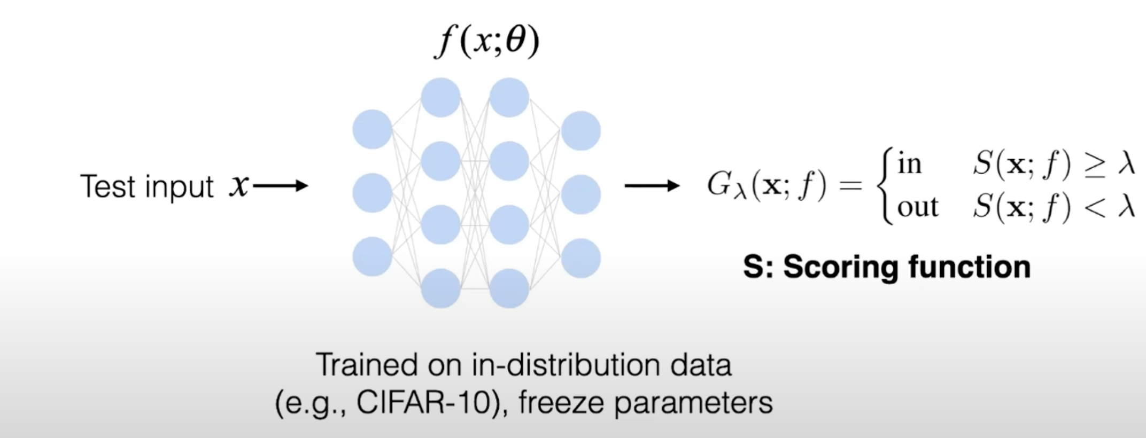
Traditional Out-of-Distribution Detection

Slide 3
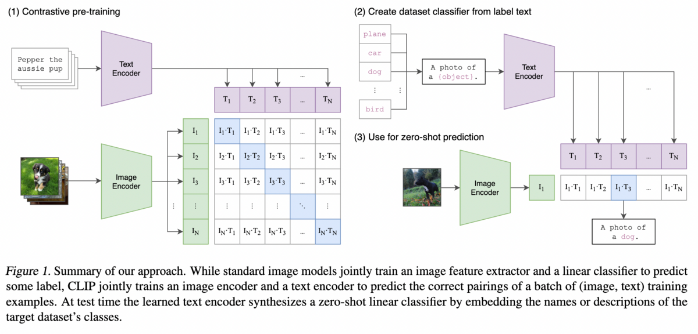
CLIP

Slide 4
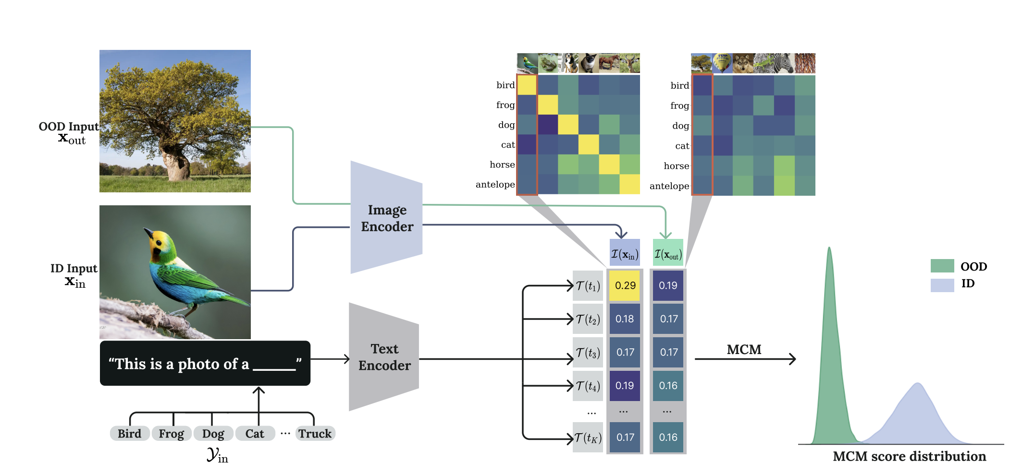
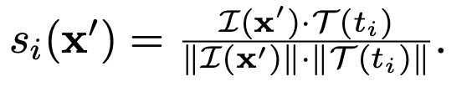
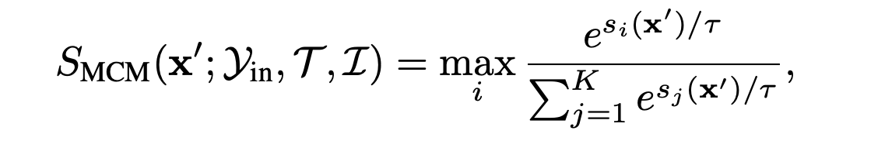
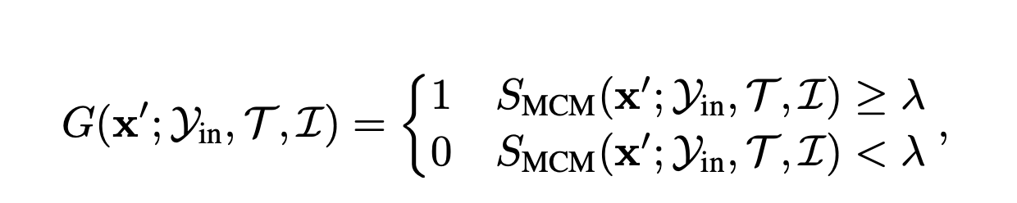
CLIP-based Zero-Shot OOD Detection
Given a pre-trained model, the goal of OOD detection is to:
detect samples that do not belong to any of the known classes;
(2) otherwise, assign test samples to one of the known classes.

Slide 5
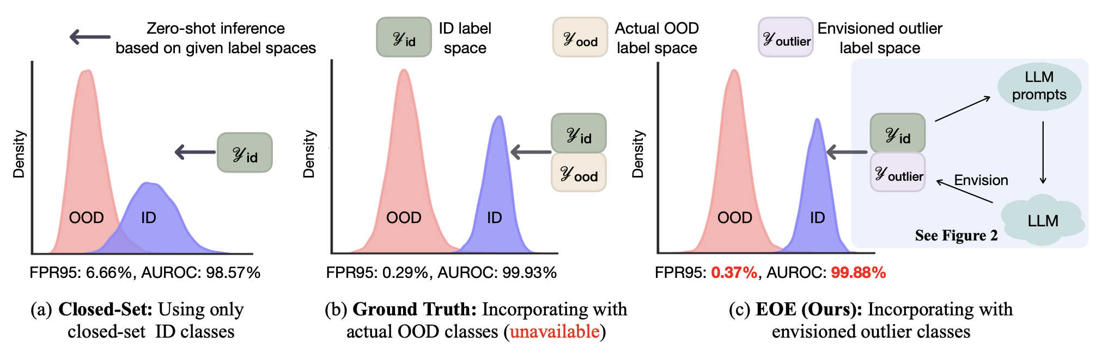
Motivation
Is it possible to generate the potential outlier class labels for OOD detection without access to test-time data?
Such an approach often fails when encountering hard OOD samples.
Design LLM prompts to generate potential outlier class labels specialized for OOD detection, following a visual similarity rule.

Slide 6
How to guide LLM to generate the desired outlier class label?
How can we sharpen the distinction between ID and OOD samples given the envisioned outlier class label?

Slide 7
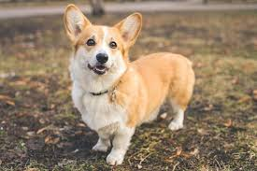
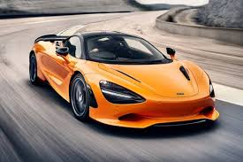
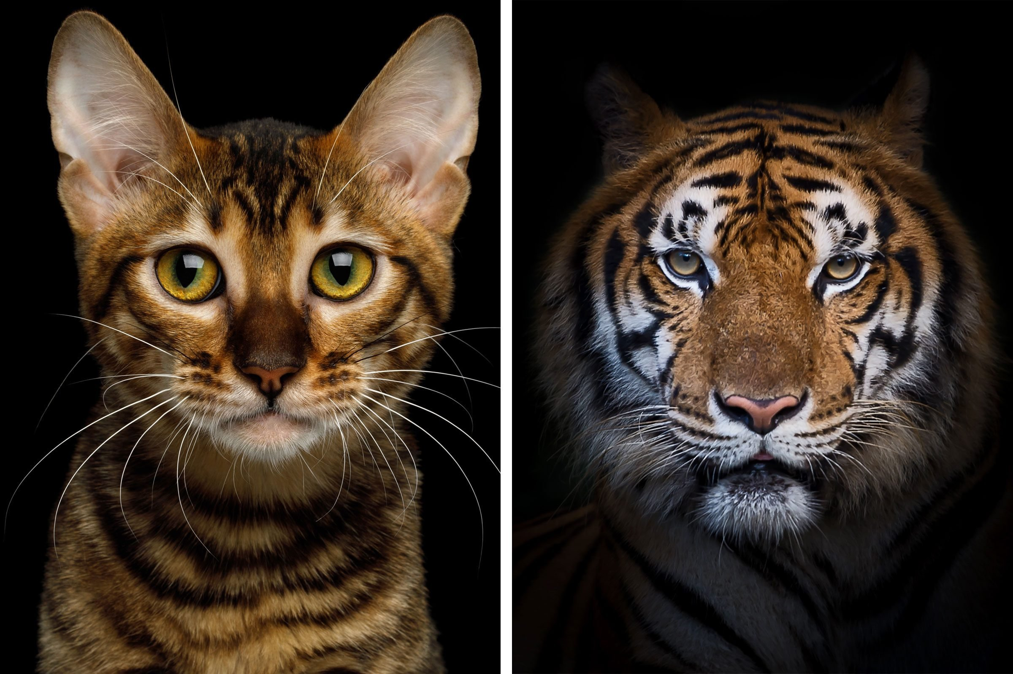
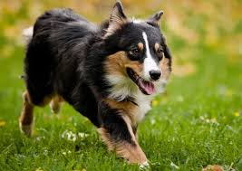
Far OOD Detection refers to identifying OOD classes that are distant from the ID classes in the label space.
Near OOD Detection pertains to identifying OOD classes that are relatively close to the ID class.
In fine-grained OOD detection, both ID and OOD samples fall under the same major category.

Slide 8
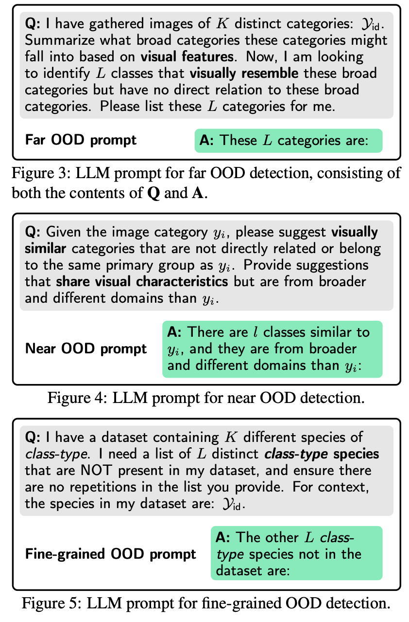
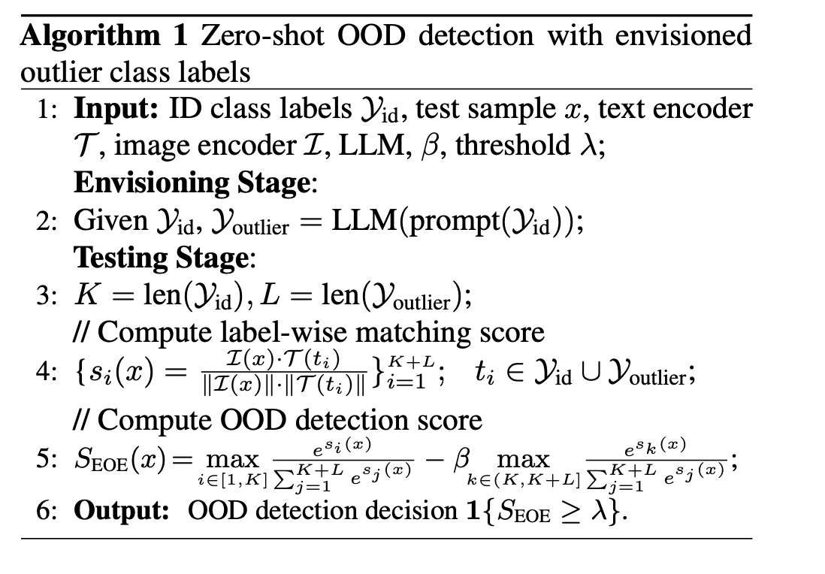
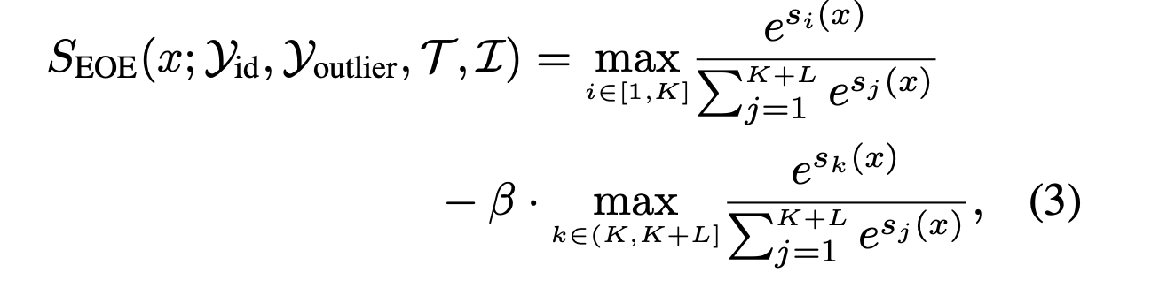
Intuition: samples visually similar to the envisioned class should have lower scores, thus making it easier to distinguish between the ID and OOD score distribution

Slide 9
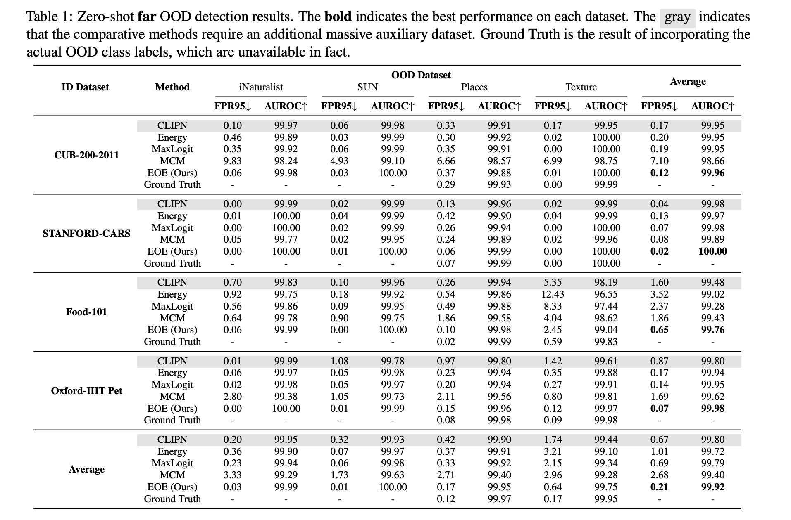
Experiments
Backbone Model: CLIP; GPT-3.5
Evaluation Metrics:
FPR95, the false positive rate of OOD data when the true positive rate is at 95% for ID data
AUROC, the area under the receiver operating characteristic curve
For each ID dataset, LLM generates 500 outlier classes

Slide 10
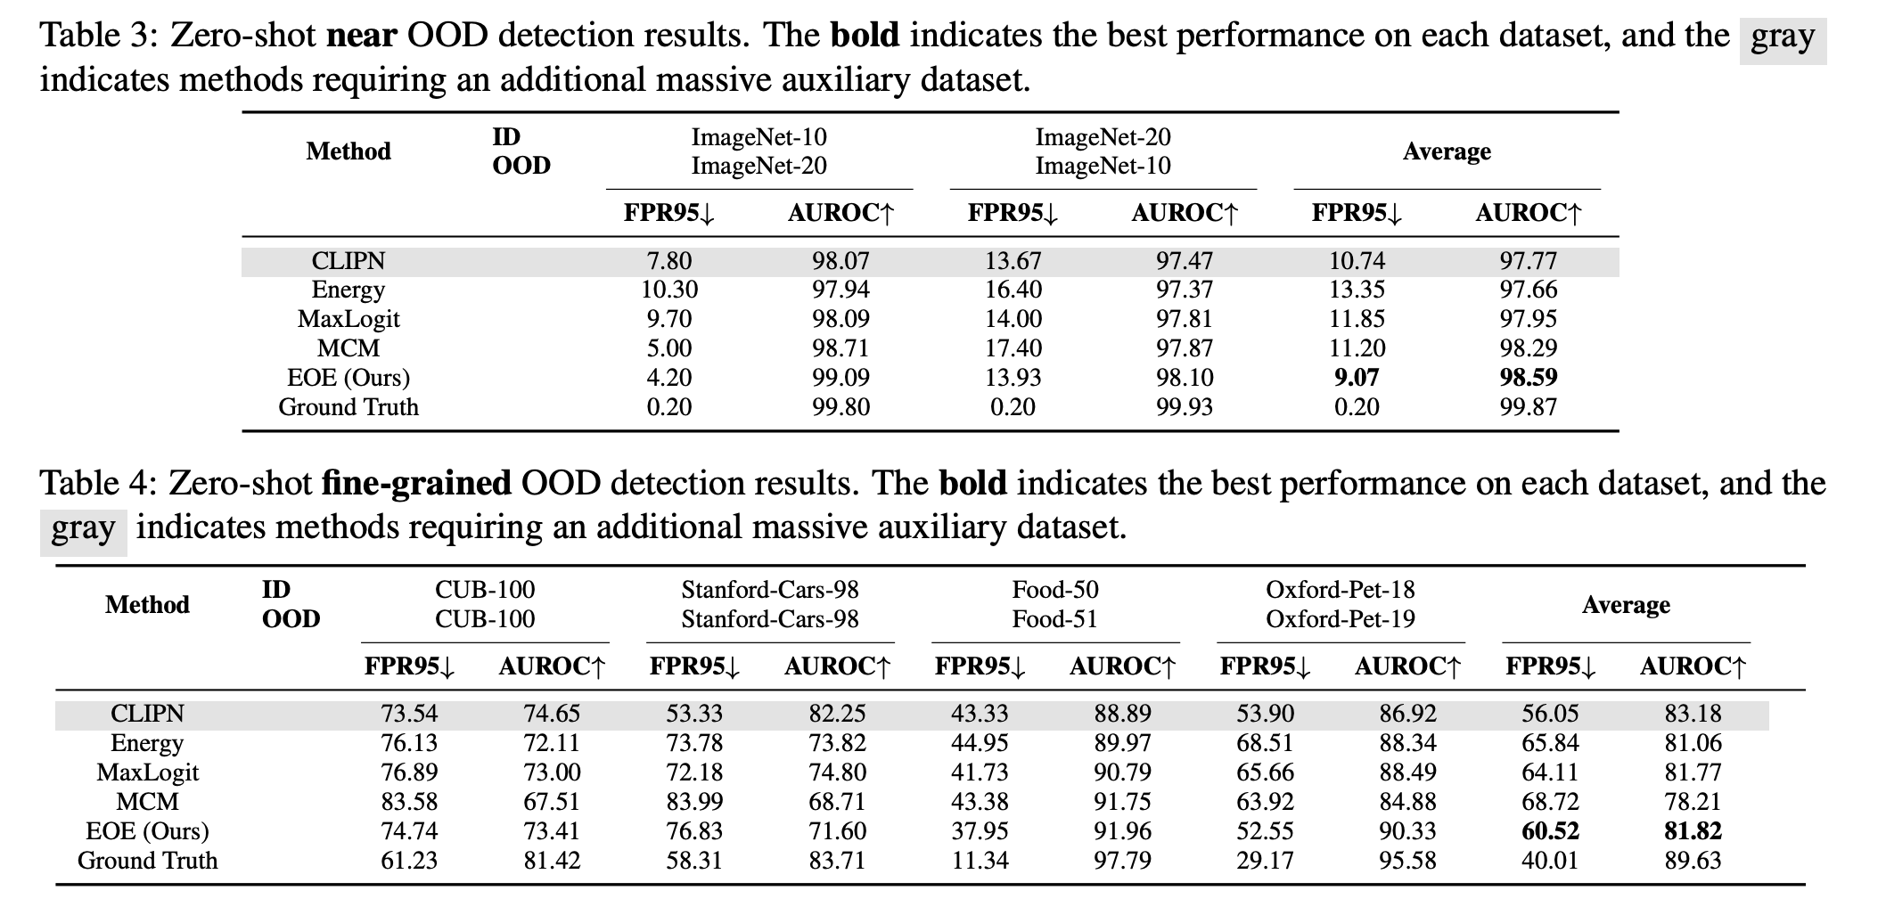

Slide 11
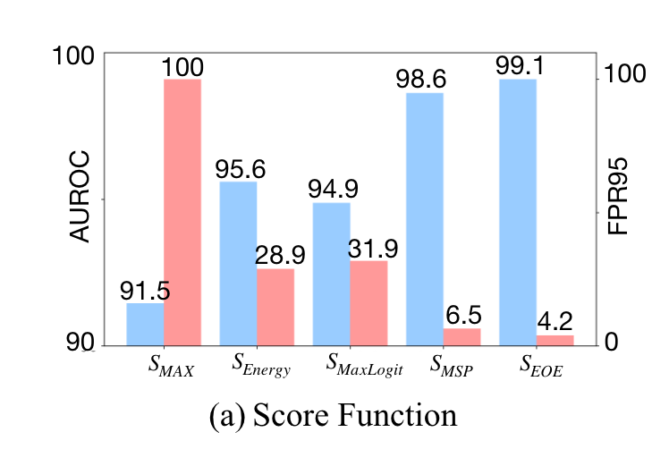
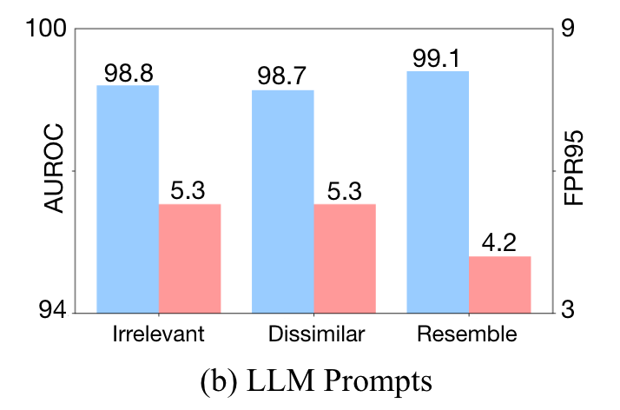
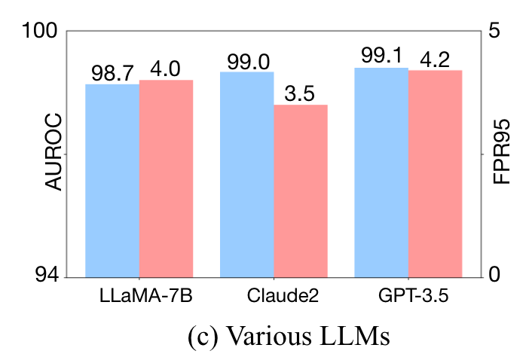
Ablation Study
Scoring functions:
LLM Prompts:
Various LLMs

Slide 12
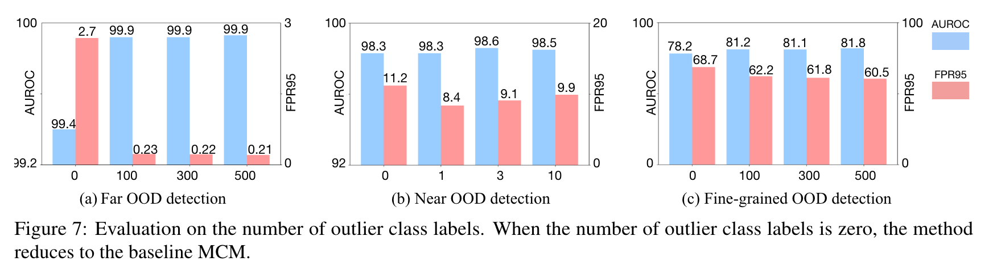

Slide 13
